Slide 1
OKC’s Economic Advance to the Future
Presentation to the
Rotary Club of Oklahoma City
September 19, 2023

Slide 2
OKC Presentation Components
“Where have we come from?”
  A Celebration of MAPS
“Did this placemaking make a difference?”
  Brief examination of differential regional economic gains
“Where are we going?”
  OKC’s Economic Base
  National/international macro economic factors
“Where does our future emphasis need to be?”
  Education and workforce development

Slide 3

A Celebration of MAPS
Placemaking

Slide 4
MAPS Programs: Stellar Design, Execution, and Stewardship
Direct community involvement in project selection
Dedicated funds from time-limited, multi-year sales tax without incurring debt
Program overseen by volunteer citizens advisory committee with final city council approval
Projects administered by separate and dedicated city staff
Projects allocated endowments for operations, without additional cost to the city’s general fund

Slide 5
MAPS 30th Year Celebration
Original MAPS—1993, $350MM, 55% Voter Approval
  Emphasis on downtown redevelopment: Civic Center Music Hall, Myriad, State Fairgrounds, Chickasaw Bricktown Ball Park, Sports Arena, Canal, Riverfront
MAPS for Kids—2001, $700MM, 61% Voter Approval
  Repaired more than 100 area schools; 30% of funds to suburban school districts
MAPS 3—2009, $777MM, 54% Voter Approval
  Quality of life emphasis: Convention Center, Public Parks, Streetcar/Transit, Fair Grounds Buildings, Trails, Sidewalks
MAPS 4—2019, $1100MM, 72% Voter Approval
  Neighborhood, human needs, quality of life, job-creating initiatives: parks, youth centers, senior wellness, mental health, transit, homelessness, Paycom Center, Fairgrounds Coliseum, beautification, multipurpose stadium, and others
https://en.wikipedia.org/wiki/Metropolitan_Area_Projects_Plan#

Slide 6
Differential Regional Economic Gains
A brief examination of real personal income (PI) ratios for MSA’s with population greater than one-half million in 1993: 87 MSA’s
Index is PI₂₀₂₁/PI_{1993*} where “*” indicates inflation-adjusted total PI
Ratio has population (Pop) and per capita personal income (PCPI) components:
  PI₂₀₂₁/PI_{1993*} = (Pop₂₀₂₁/Pop₁₉₉₃) x (PCPI₂₀₂₁/PCPI_{1993*})
Findings:
  Oklahoma City MSA is in the top 30% of all large metro areas in total ratio and compares to:

Slide 7
Differential Regional Economic Gains
Additional Findings:
  Oklahoma City MSA is doing quite a bit better than surrounding MSA’s:
  Oklahoma City MSA is not doing as well as major Texas MSA’s

Slide 8

OKC’s Economic Base
Results for OK County from the Quarterly Census of Employment and Wages (QCEW)
Location Quotient or Coefficient:

Slide 9




Greater OKC Project Pipeline Deal Flow
August 2023
35,000 Jobs
96
Projects
$32 Billion Capital Investment
$900 Million Payroll
Note: Not all projects provide the key pieces of information listed above; Pipeline as of August 2023; Greater OK Chamber
Notes:
Oklahoma City continues to be an attractive location for companies looking to relocate or expand. Currently, the Greater Oklahoma City Chamber economic development team is working 96 projects involving companies looking to locate or expand in the Oklahoma City area.
Those projects consist of:
35,000 jobs
$32 billion in capital investment
$900 million in Payroll
National site consultants are telling us that they have seen and expect to see a continual slowdown of office relocation projects over the next 5 years. But, manufacturing projects are still strong, making up 60% of all the projects looking at Oklahoma City. Companies are still looking at reshoring opportunities to bring back their supply chains to the United States.

Slide 10

Are Fossil Fuels “Dead Money?”
Answer: “No, but go ahead and pursue public policies to act so and see where that gets you!”

Slide 11
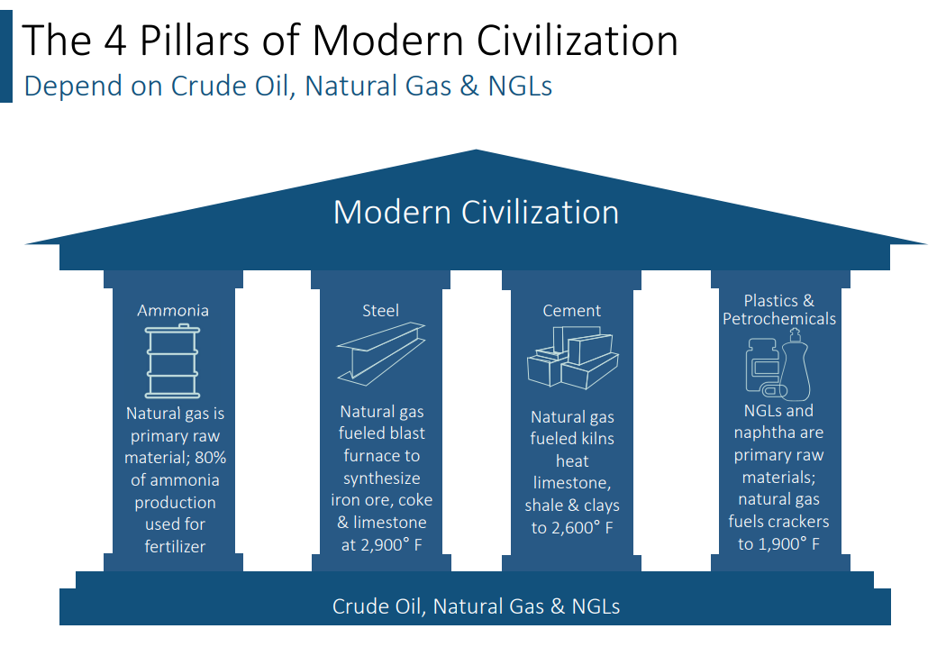
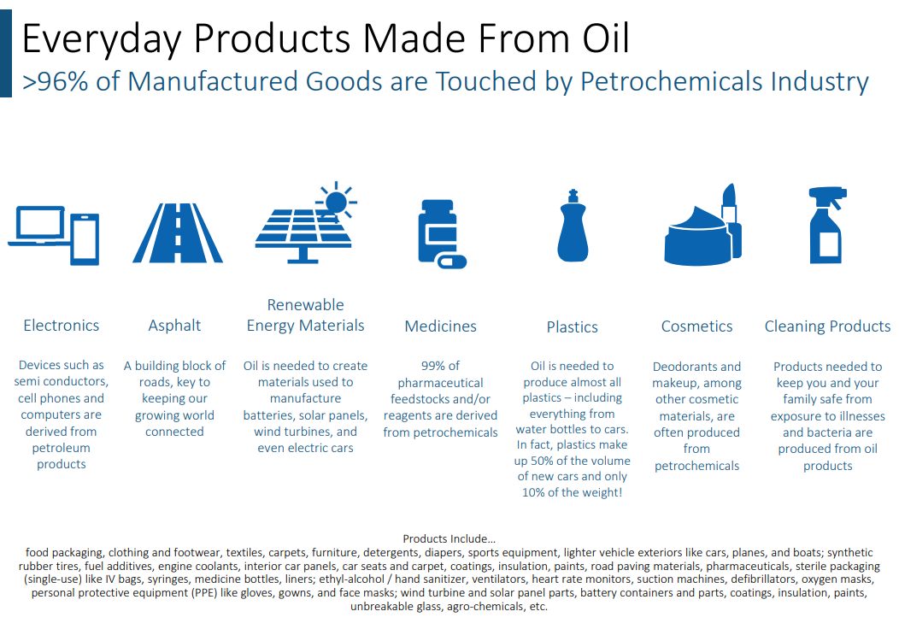
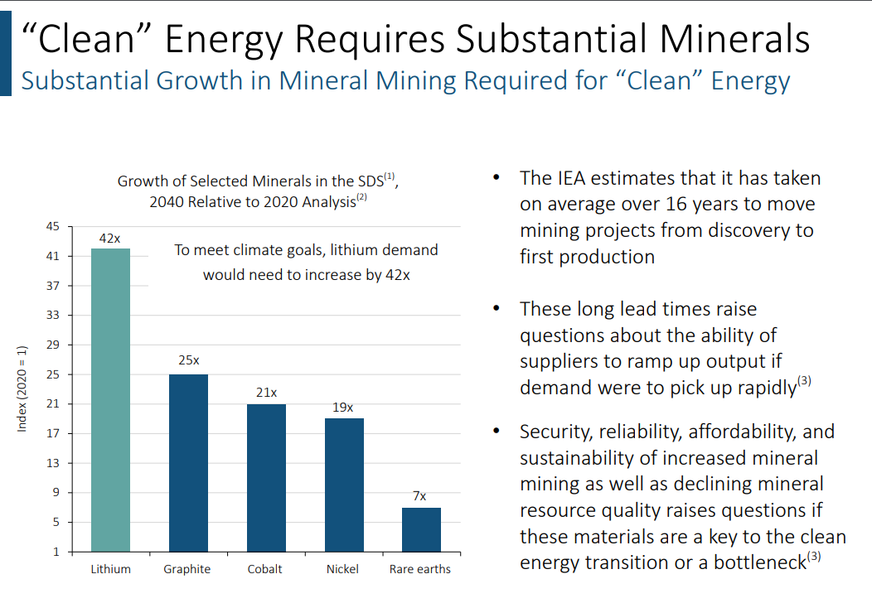
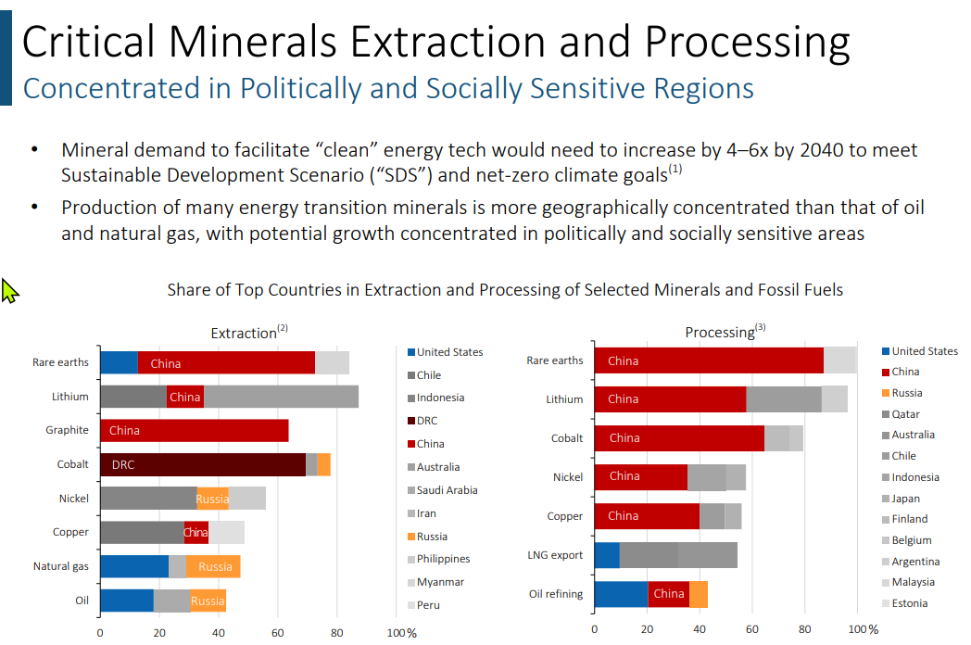
Source: Enterprise Products Partners Investor Deck, 5/2023

Slide 12
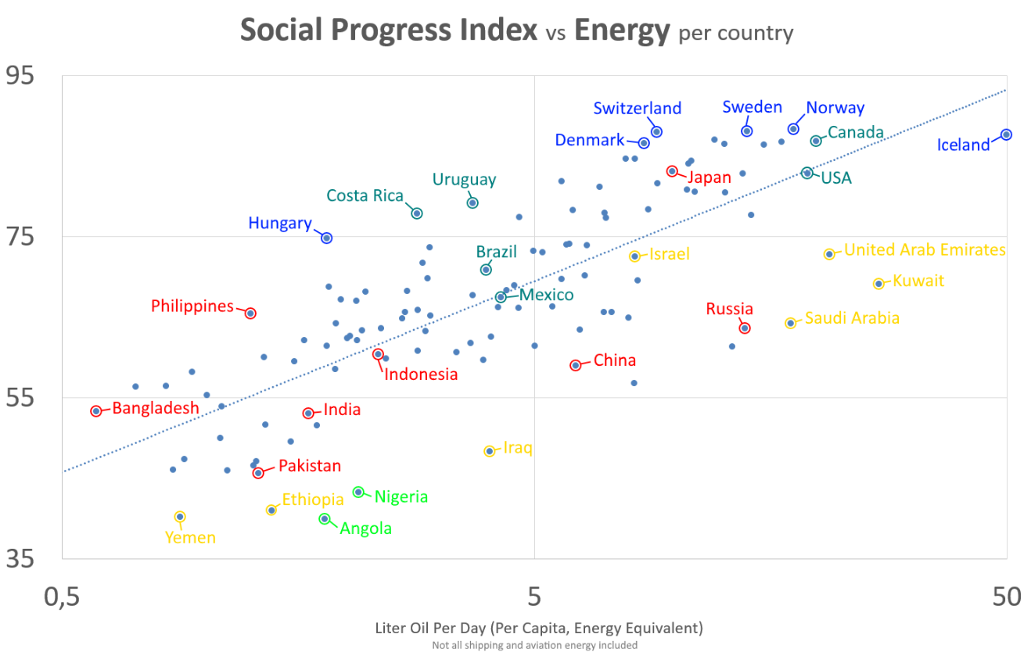
Sources: U.S. Energy Information Administration (EIA); Energy Institute Statistical Review of World Energy (2023); Gapminder (v7); United Nations, World Population Prospects (2022); HYDE (v3.2); Gapminder (Systema Globalis)

Slide 13
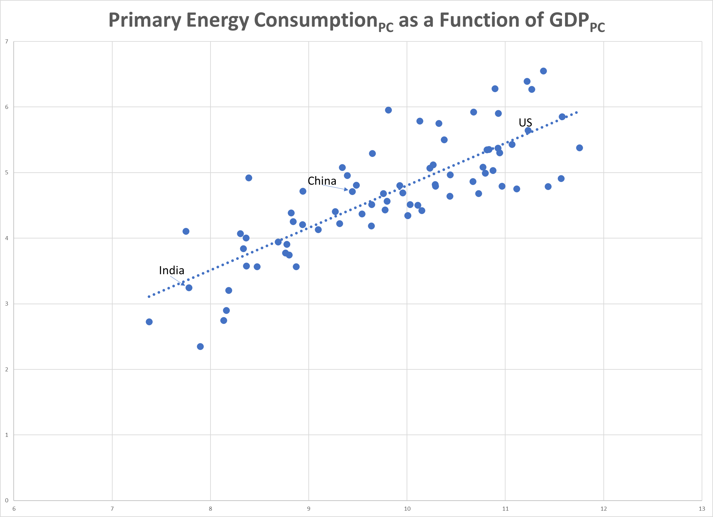
Primary energy consumption per capita is regressed on GDP per capita for 75 countries. The model is in double-log form, enabling direct computation of the elasticity of consumption with respect to GDP_{PC}. The estimated elasticity is 0.646, indicating that a 10% change in GDP_{PC} is associated with about a 6.5% change in energy per capita consumption. The model explains 2/3rds of the total variation.
Recent Estimates place Q1 2013 at a 1.6% gain
Notes:
From GDP Special Graph

Slide 14
Is a Recession Looming?
Let’s briefly examine:
  Government spending
  Inflation trends
  Energy prices
  Interest rates
  Status of the consumer
  Employment trends
  Economic indicators

Slide 15
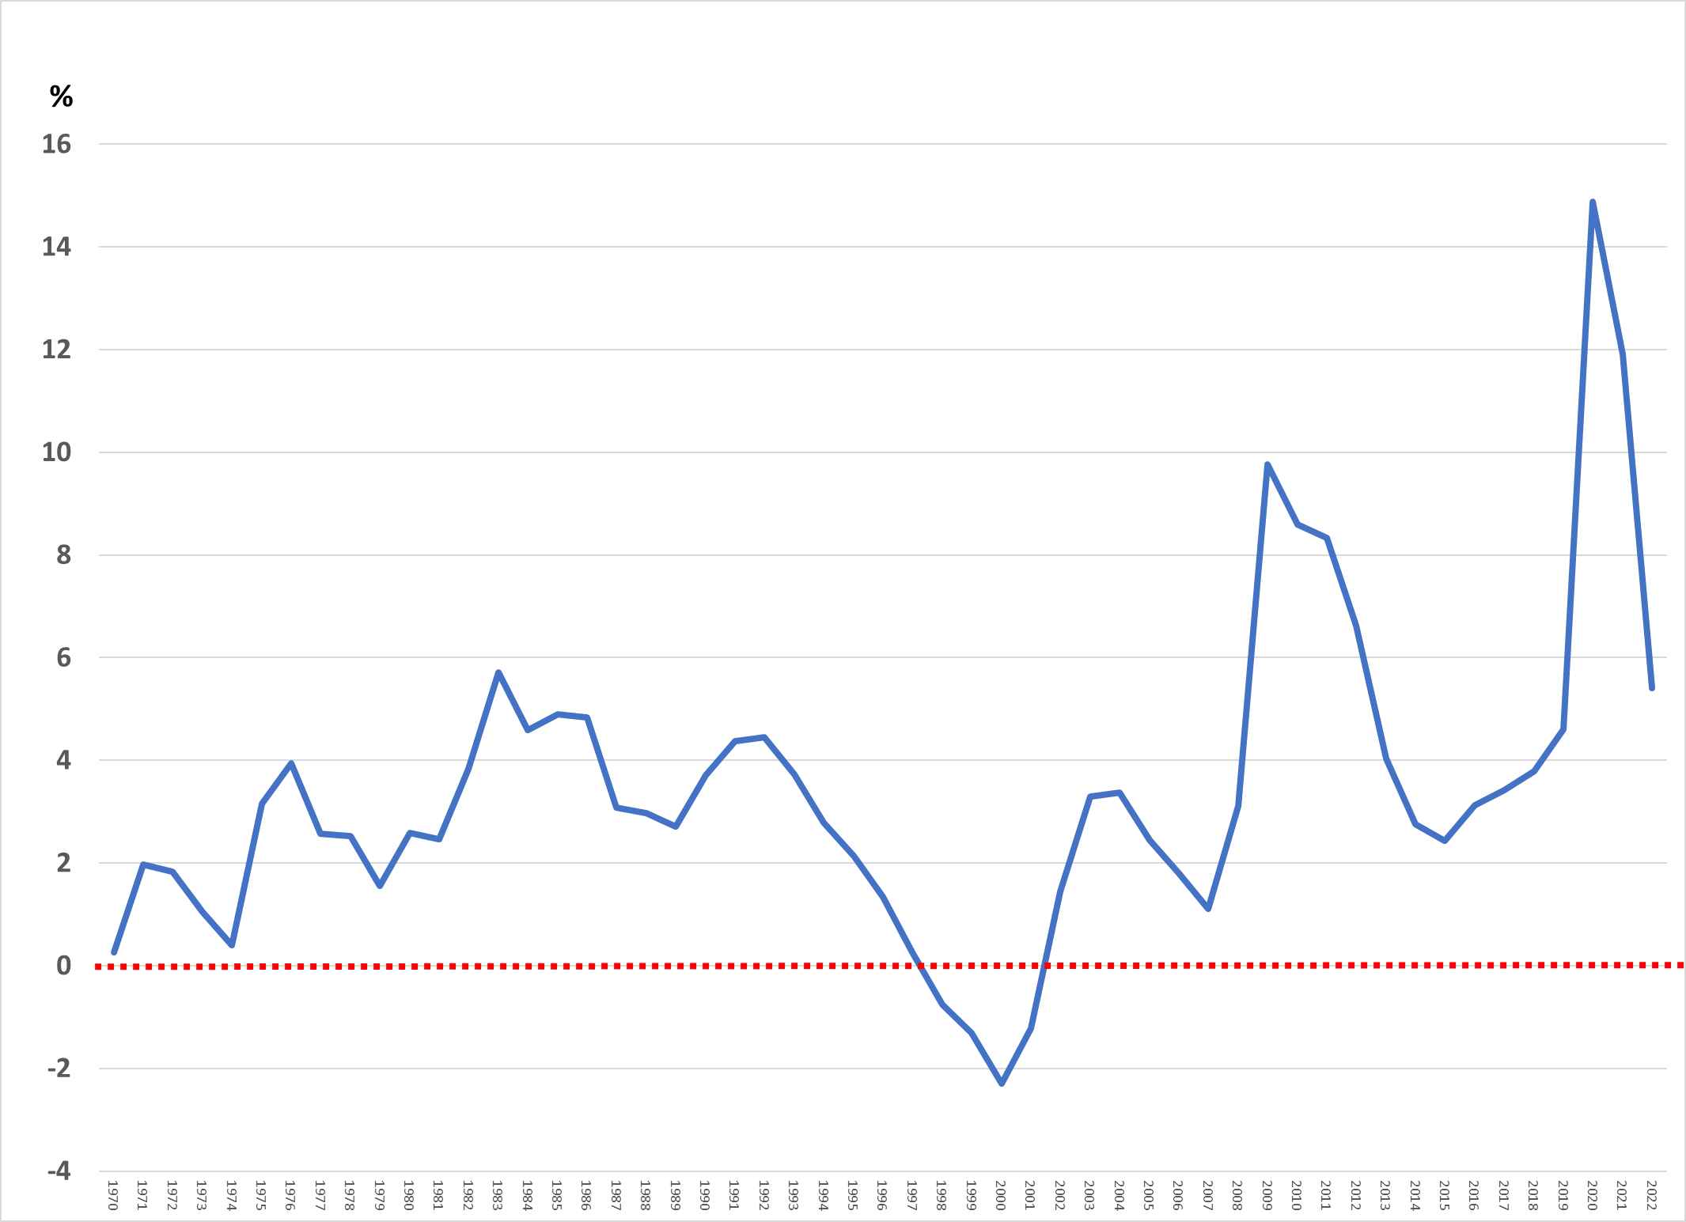
Federal Deficit as Percentage of GDP
Source: https://fred.stlouisfed.org/series/FYFSGDA188S

Slide 16
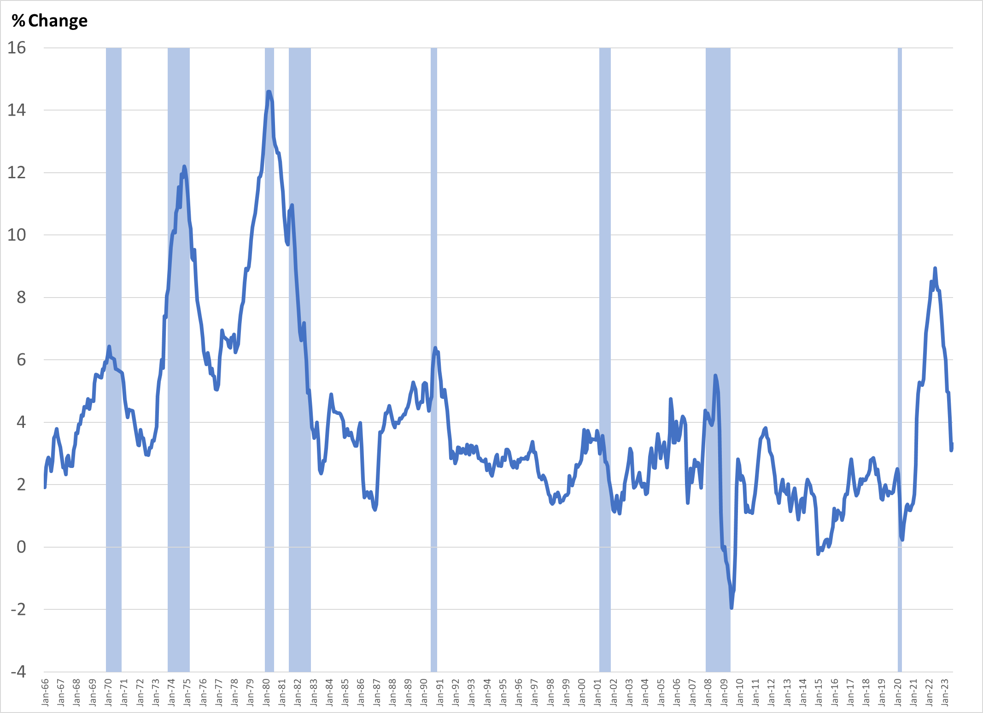
CPI Headline Inflation: Yr/Yr % Change

Slide 17
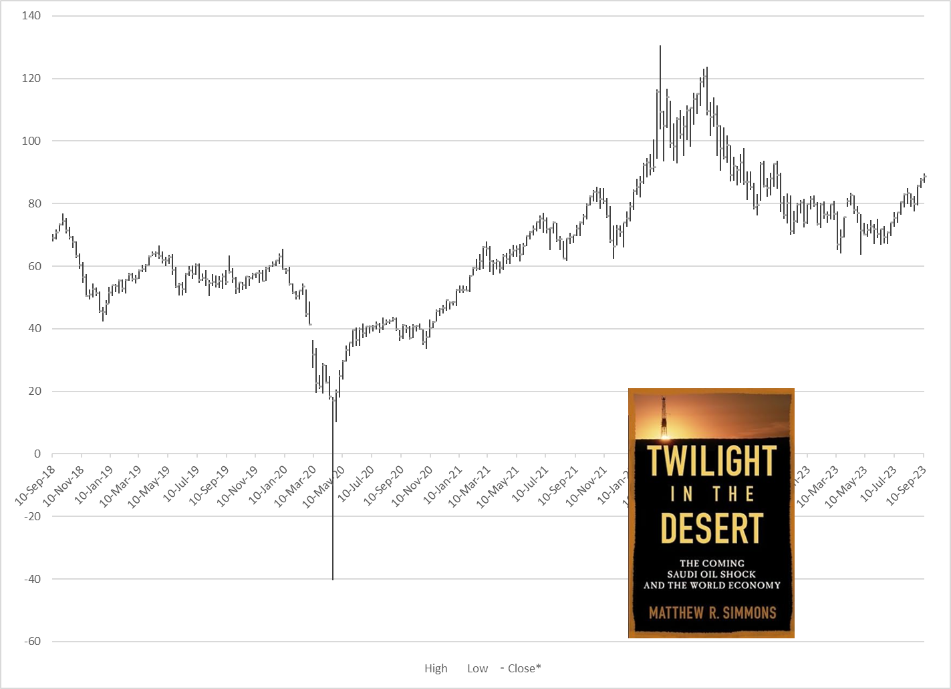
WTI: West Texas Intermediate Crude
Current Month Contract—Weekly High, Low, Close

Slide 18
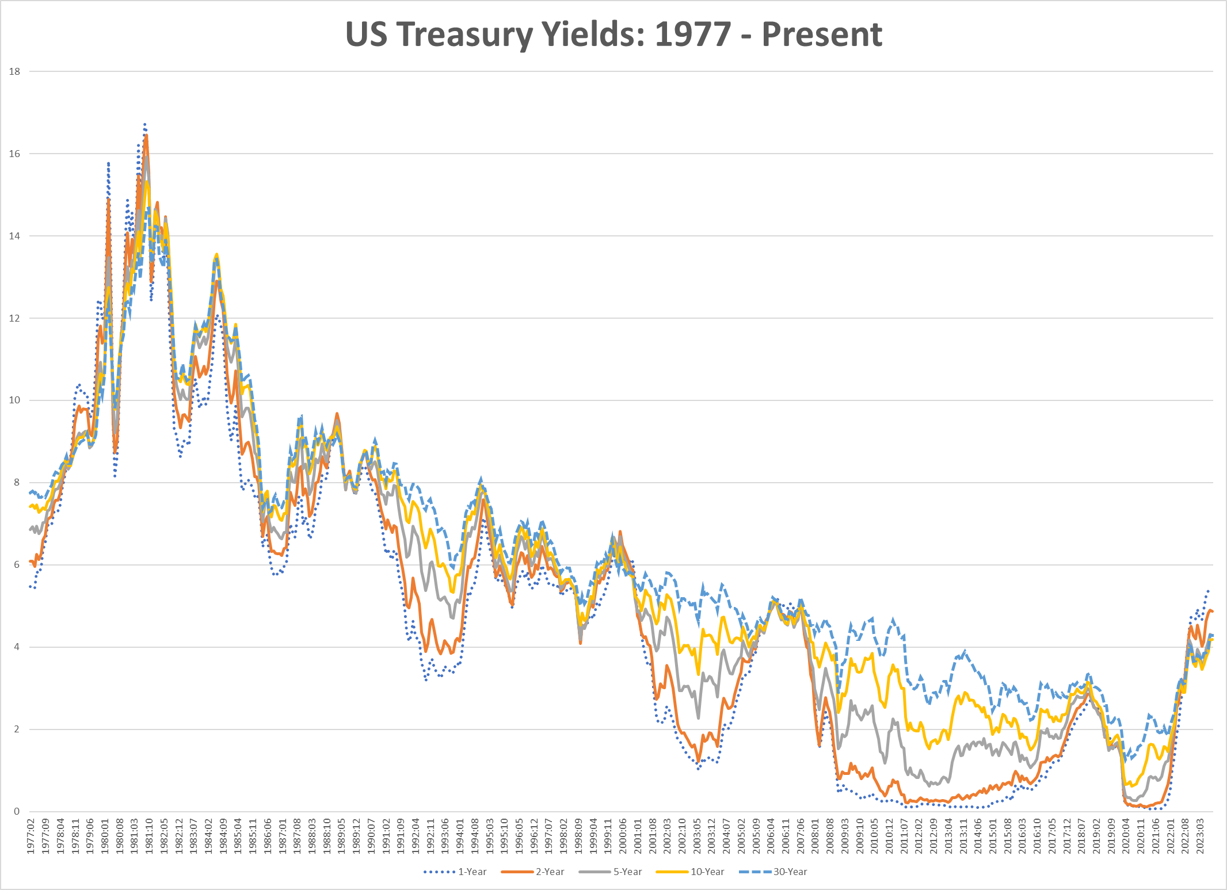
US Treasury Yields: 1977-2023

Slide 19
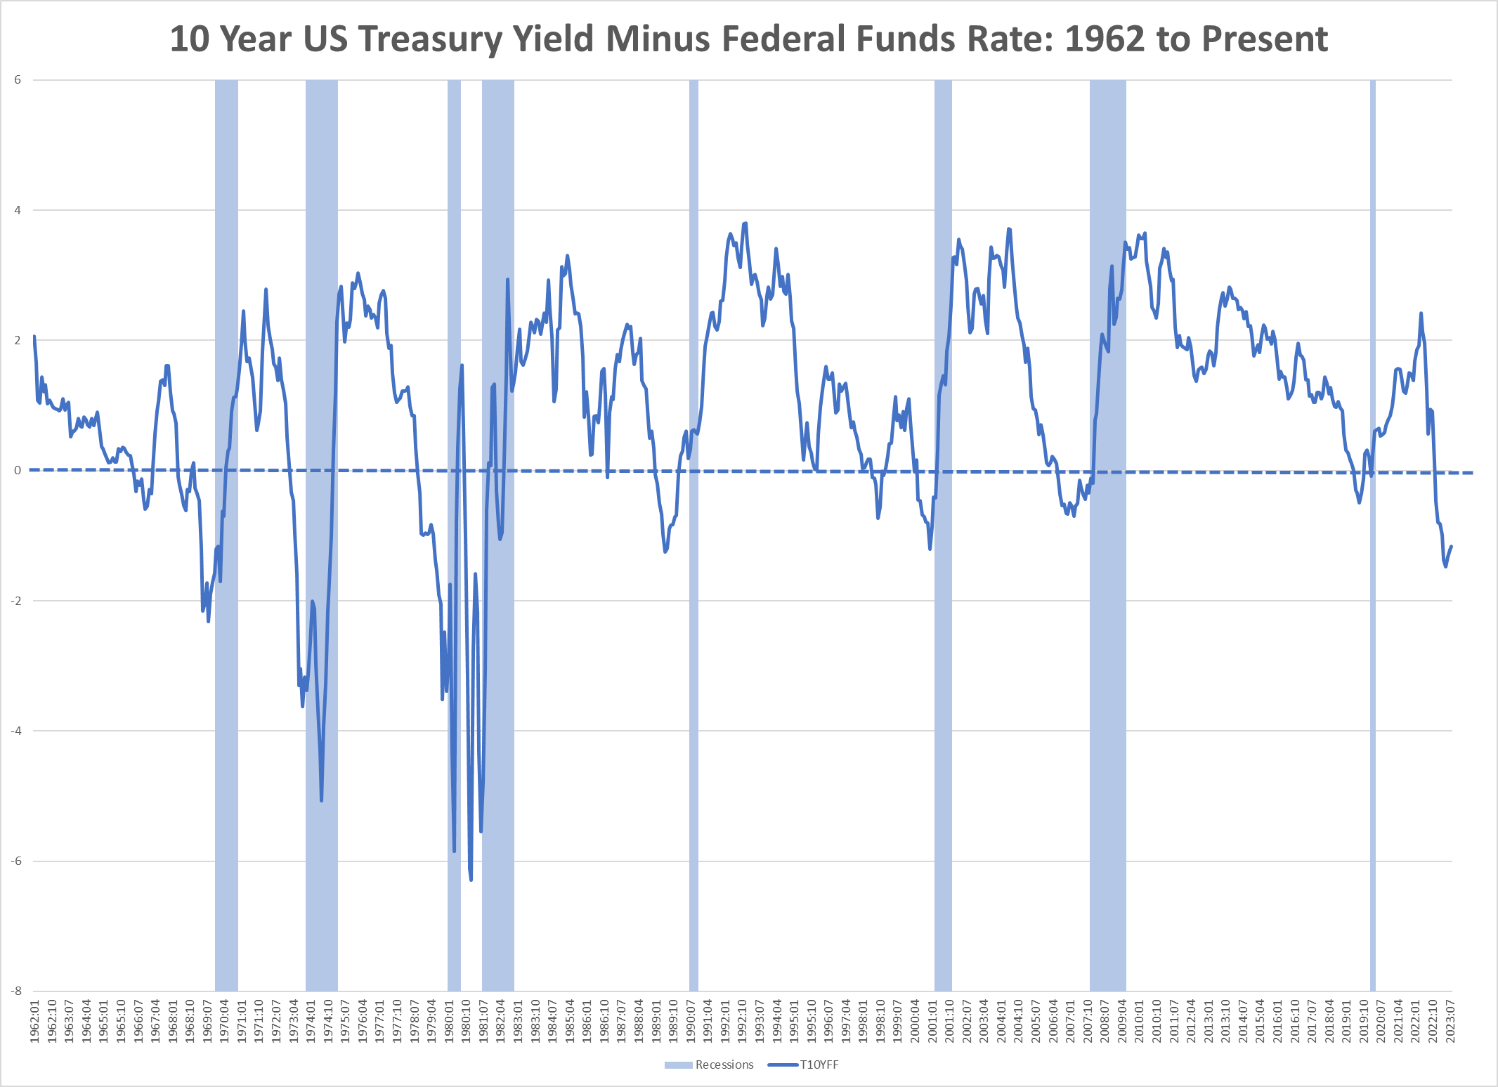
10 Year US Treasury – Fed Funds

Slide 20
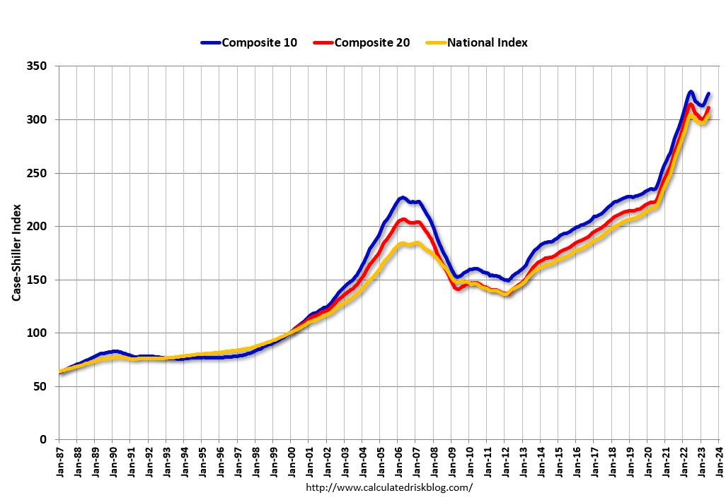
Housing Price Indices

Slide 21
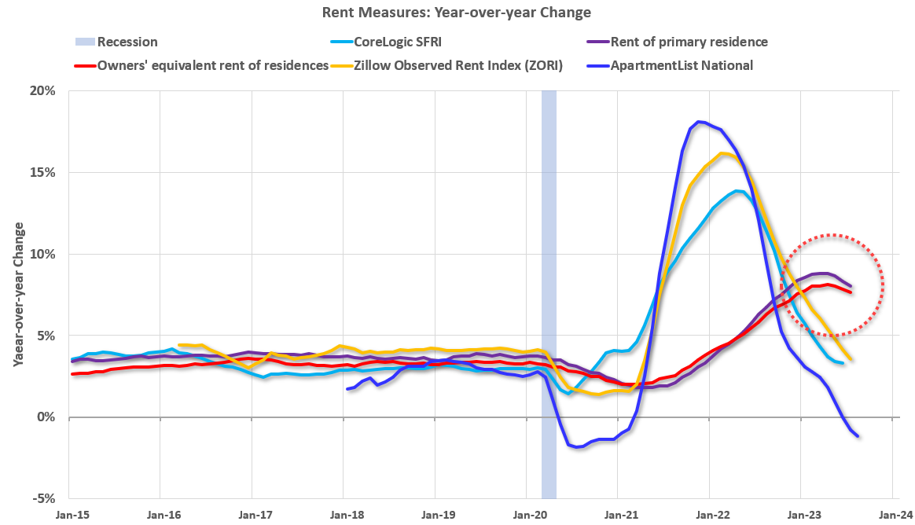
Rent Measures Coming Down

Slide 22
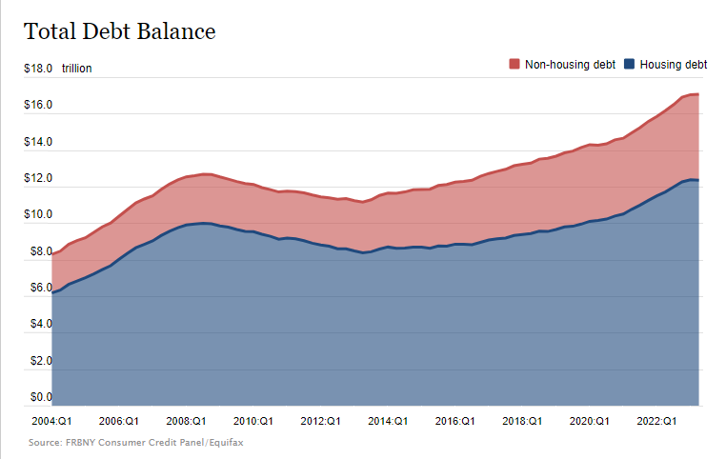
Household Sector Debt

Slide 23
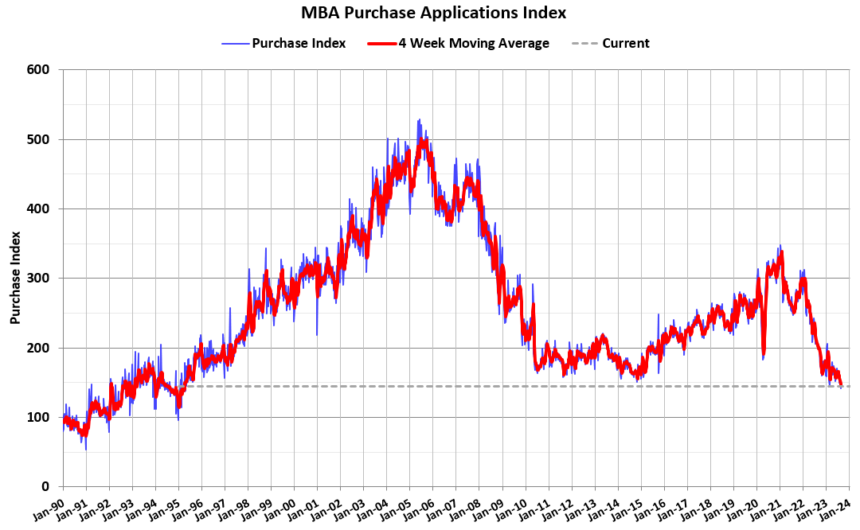
Mortgage Purchase Applications
Source: calculatedriskblog.com

Slide 24
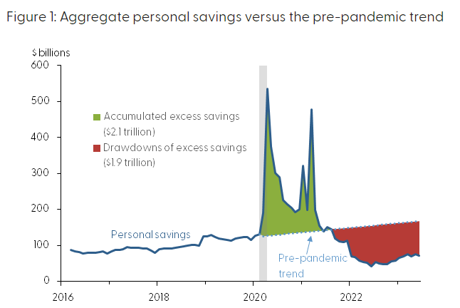
Pandemic-Era Excess Savings Drawdown
Source: https://www.frbsf.org/our-district/about/sf-fed-blog/excess-no-more-dwindling-pandemic-savings/

Slide 25
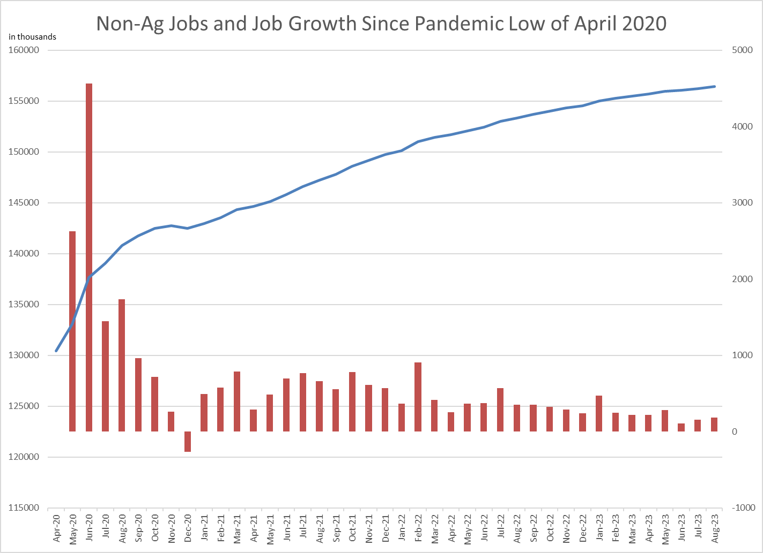
Post Pandemic Job Growth

Slide 26
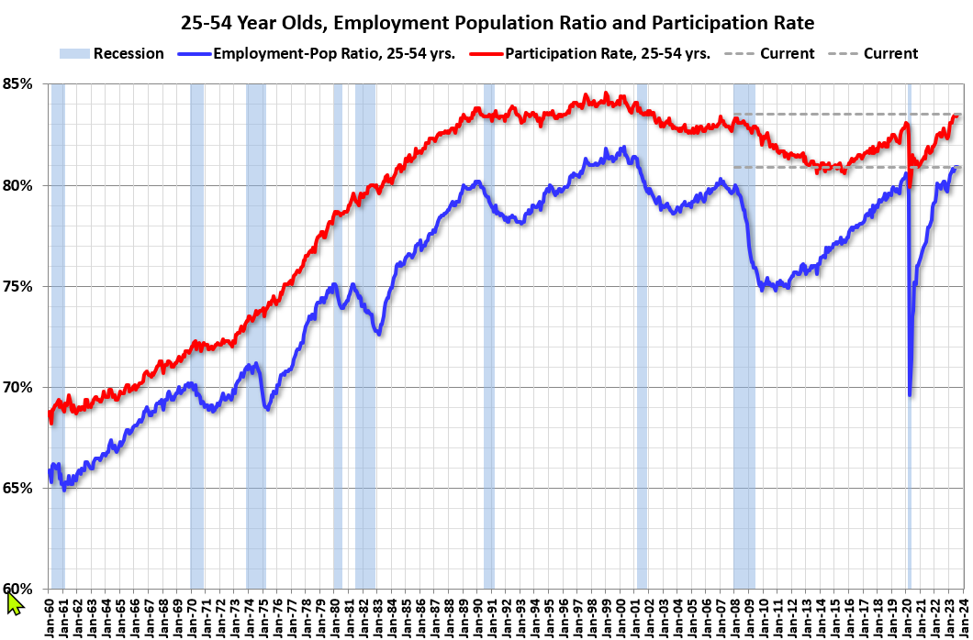
Prime Working Age Population

Slide 27
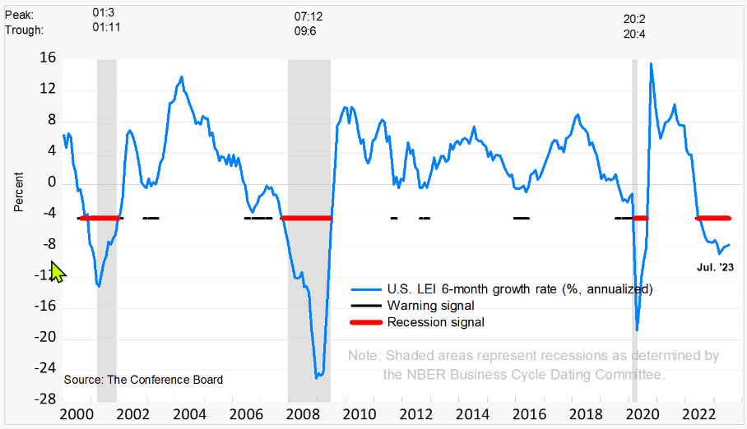
Conference Board Leading Economic Indicators

Slide 28
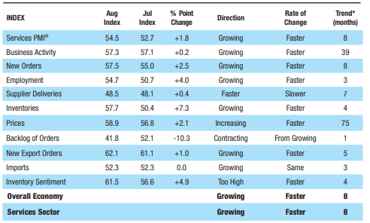
Services Purchasing Managers Indicator (PMI)

Slide 29
Suggested Future Emphasis
Education and Workforce Development
Back to Location Quotients
  QCEW March 2023—Oklahoma County
  Value of 1.0 → For a given industry, the proportion of total employment or wages locally matches the proportion nationally

Slide 30

That’s all, folks!
"An economist is an expert who will know tomorrow why the things he predicted yesterday didn't happen today.“ Laurence Peter

